Slide 1
04-01. Data exploration, preprocessing
Dept. of Computer Information & Science
Youngsoo Kim <pineland@hanmail.net>
Code : https://github.com/pineland/AIDA/

Slide 2
Outline
Data exploration
Variable identification
Univariate / bivariate Analysis
Data preprocessing
Why preprocessing ?
Main tasks in data preprocessing

Slide 3
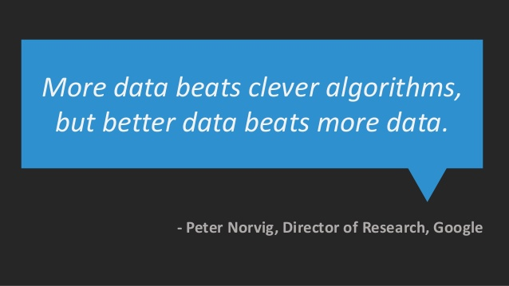


Slide 4
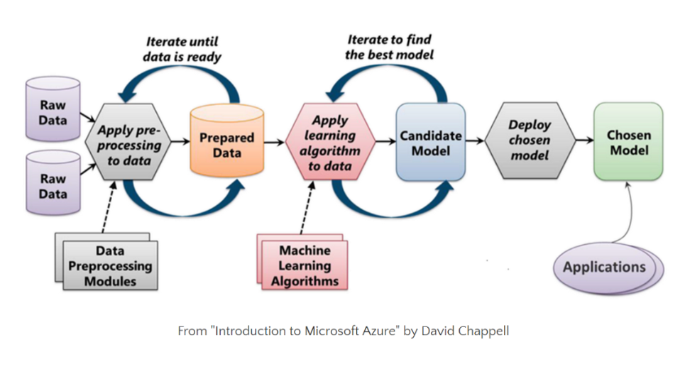
Machine learning process

Slide 5
Data exploration (DE)
Definition
A preliminary exploration of the data to better understand its characteristics.
Key motivations of DE
Help to select the right tool for preprocessing or analysis.
Promote better recognition of patterns.
Phase
Variable identification
Univariate / bivariate / multivariate Analysis

Slide 6
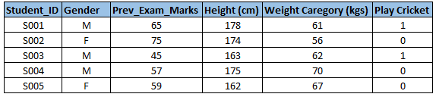
DE - Variable identification
Identify predictor (Input) and target (output) variables.
e.g. we want to predict whether the students will play
cricket or not
Identify the data type and category of the variables.
Data type : character, numeric, descriptive form, etc.
Category : numerical(continuous), categorical

Slide 7
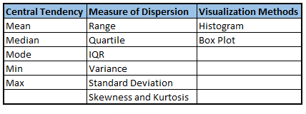
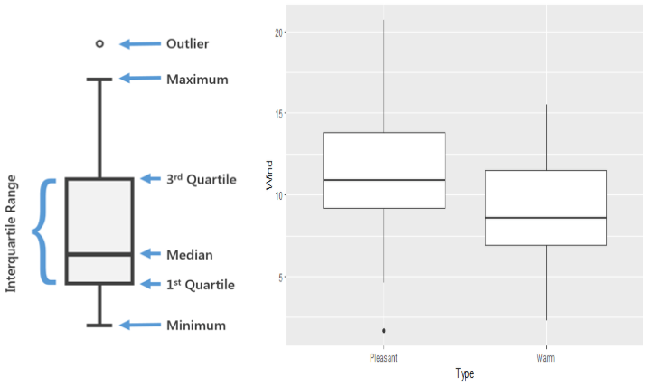
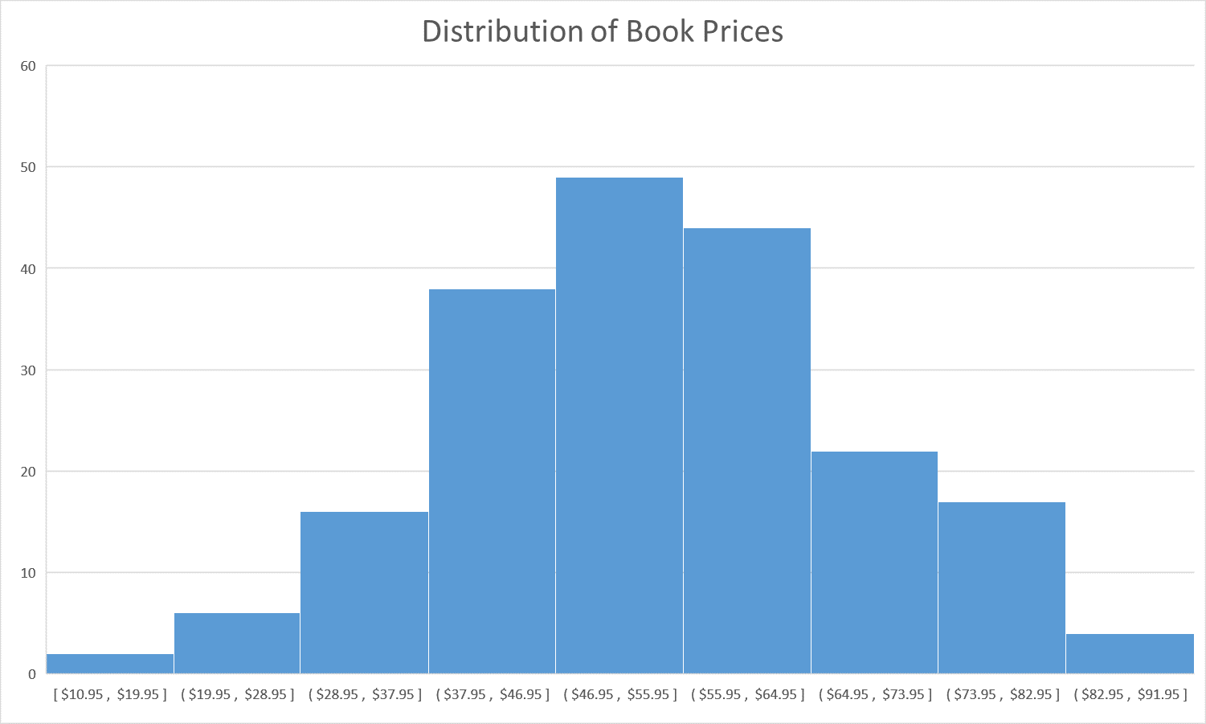
DE - Univariate Analysis
Numerical variables
Various statistical metrics visualization
find the tendency of data, missing and outlier values.

Slide 8
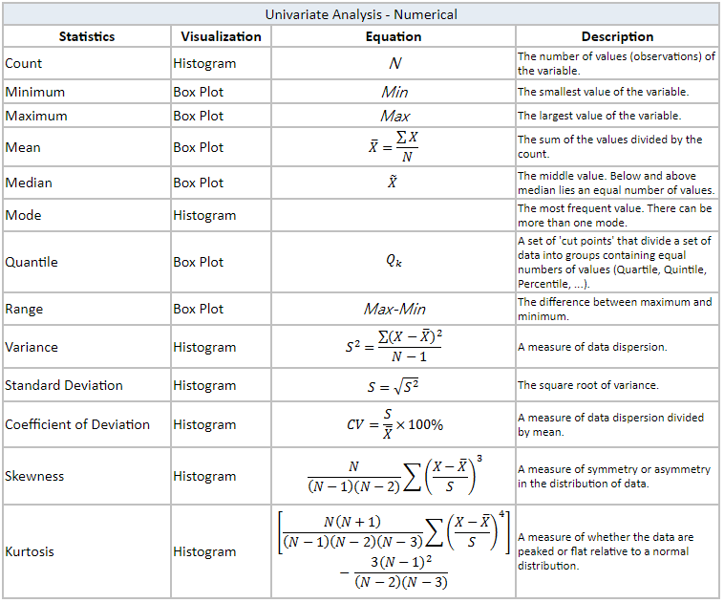
[ref] Variables of univariate analysis

Slide 9
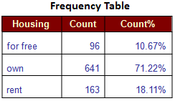

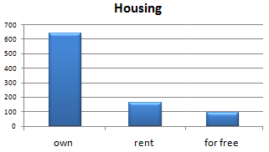
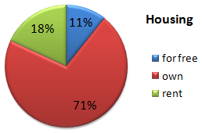
DE - Univariate Analysis
Categorical variables
Use frequency table to understand distribution of each category.
read count and percentage of values under each
category.
Notes:
https://www.analyticsvidhya.com/blog/2016/01/guide-data-exploration/

Slide 10
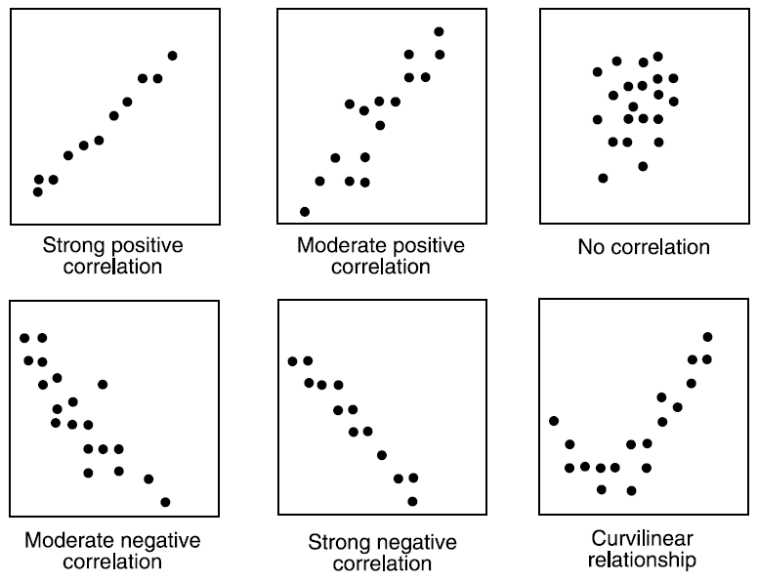
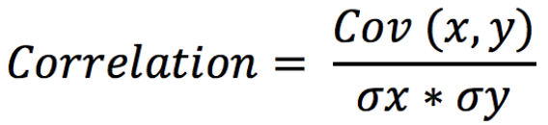
DE – Bivariate Analysis
Numerical vs. Numerical
finds out the relationship between two variables.
-1 : perfect negative linear correlation
+1 : perfect positive linear correlation
0 : No correlation

Slide 11
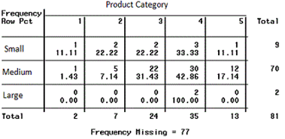
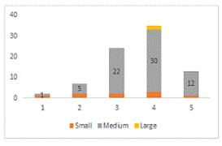
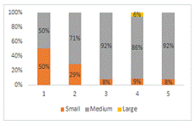

DE – Bivariate Analysis
a more visual form of Two-way table
Categorical vs. Categorical
Two-way table
Stacked Column Chart
Other statistical method :
Chi-square Test

Slide 12
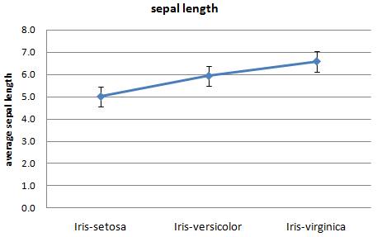
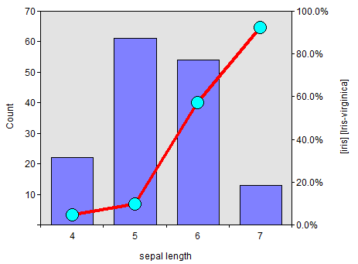
DE – Bivariate Analysis
Numerical vs. Categorical
Line Chart with Error Bars
Combination Chart
Other statistical methods : z-test, t-test, …

Slide 13
DE - Multi-variate Analysis
Scatter plots
Two-dimensional scatter plots most common, but can have three-dimensional scatter plots.
Often additional attributes can be displayed by using the size, shape, and color of the markers that represent the objects.
It is useful to have arrays of scatter plots can compactly summarize the relationships of several pairs of attributes.
See an example on the next slide.

Slide 14
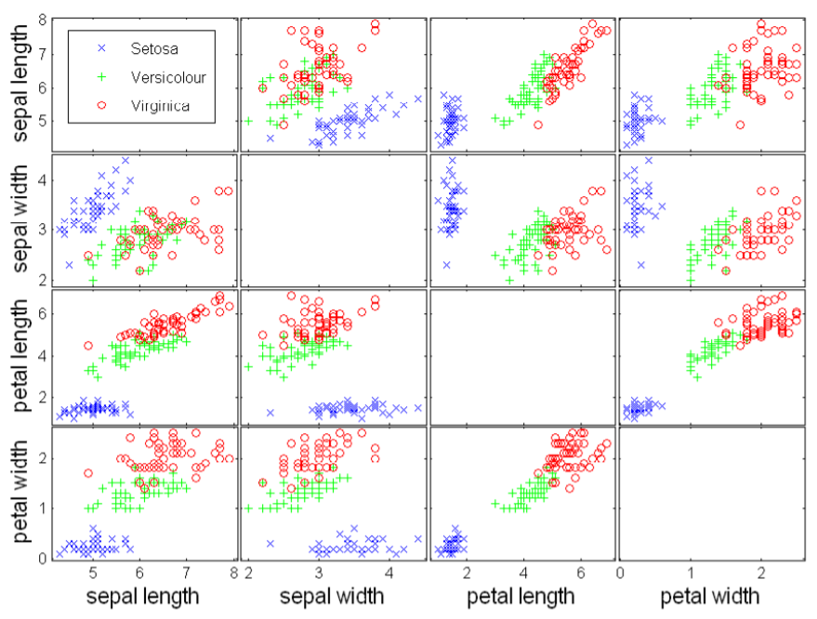
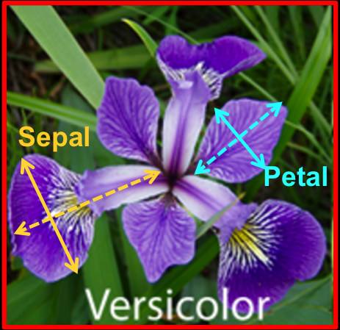


DE - Multi-variate Analysis
Example of scatter plots: Iris attributes

Slide 15
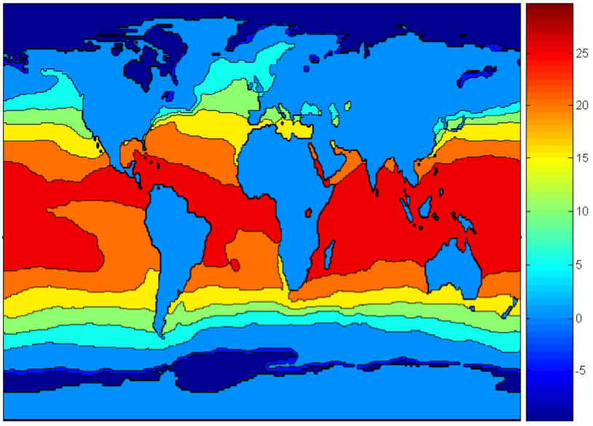
DE - Multi-variate Analysis
Contour plots
Used to plot continuous attributes on a spatial grid such as temperature, rainfall, etc.
e.g.) Earth's sea level temperature

Slide 16
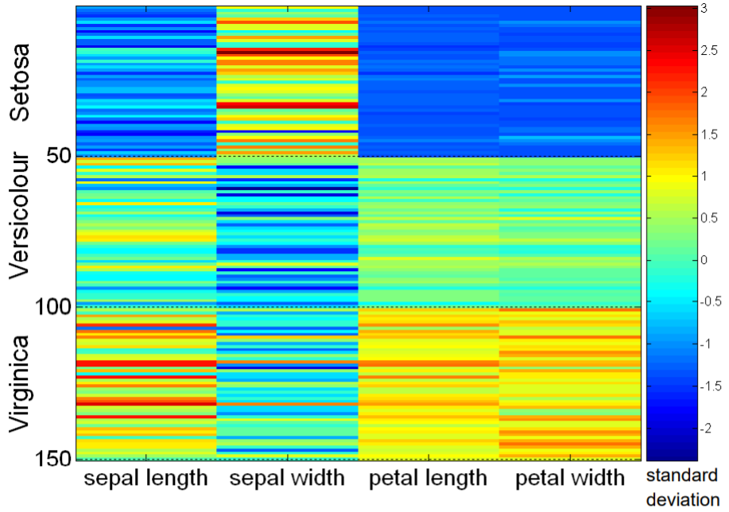
DE - Multi-variate Analysis
Matrix plots
Used to plot the data matrix.
Typically, the values of attributes are normalized.

Slide 17
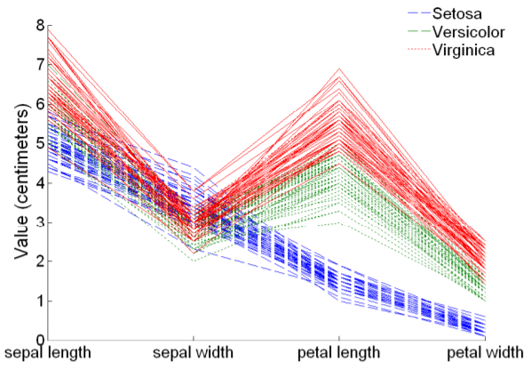
DE - Multi-variate Analysis
Parallel Coordinates
The attribute values are plotted as a point on each corresponding coordinate axis, and the points are connected by a line.
Instead of using perpendicular axes, use a set of parallel axes.
Usually used to
plot the high-
dimensional data.

Slide 18
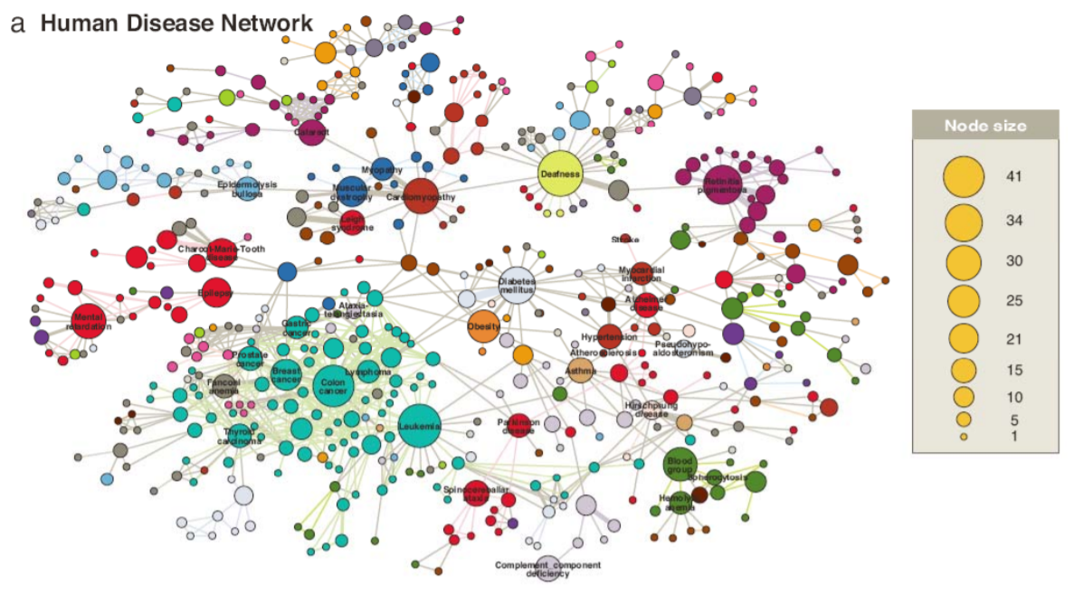
DE - Multi-variate Analysis
Graph
Plot the relations between various nodes(variables)

Slide 19
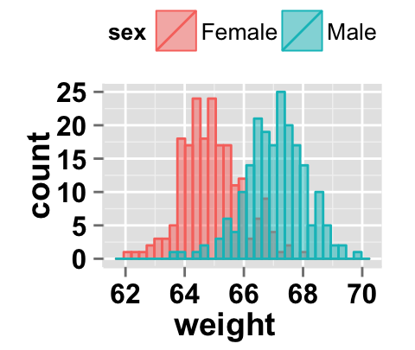
DE - Multi-variate Analysis
Other techniques
If the statistical analysis results are ambiguous,
separate the data into several sections.

Slide 20
Why Preprocessing (PP) ?
Real-world data is often incomplete, inconsistent, and/or lacking in certain behaviors or trends, and is likely to contain many errors.
out-of-range values (e.g., Income: −100), impossible data combinations (e.g., Sex: Male, Pregnant: Yes), missing values, etc.
Learning algorithms have affinity towards certain data.
Unscaled or unstandardized data have might have unacceptable prediction.
“Gabage In, Gabage Out”

Slide 21
Main tasks in Data preprocessing
Data cleaning
Data integration
Data reduction
Data transformation

Slide 22
PP - Data cleaning (cleansing)
Fill in or handle missing values
Mean, median, most frequent value, kNN or etc.
Remove the record
Identify outliers and smooth out noisy data
Treat outliers similar to missing values
Pass a specific filter to noisy data
Correct inconsistent data
eg. H. Smith, H.Smith, HSmith, H Smith, etc

Slide 23
PP - Data integration
Integrate multiple DBs, data cubes, or files without redundancy
Combine several columns of the same content into one.
e.g.) object identification (ID)
Be careful of the heterogeneities of names, meanings, data representation methods between different domains
Redundant attributes may be able to be detected by correlation analysis

Slide 24
PP - Data reduction
Eliminate unnecessary columns (feature selection).
Data with a high percentage of missing values
Highly correlated data
Data with lower importance (in a tree-based model)
Data with a single unique value
Data with low variance
Have the same value in all samples
Compress too detailed data.
Image, sound, a descriptive sentence, document, etc.

Slide 25
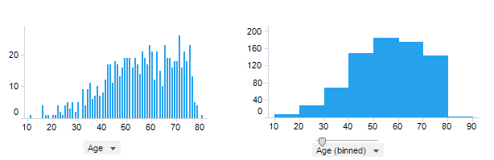
PP - Data reduction
Data discretization (Binning)
Diminish data from a large domain of numeric values to a subset of categorical values
e.g.) age, temperature, health data
It causes that the learning methods show remarkable improvements in learning speed and accuracy

Slide 26
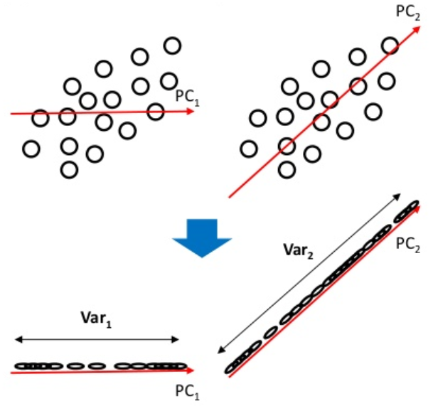
PP - Data reduction
Dimensional reduction
Principal component analysis (PCA)
Reduce dimensions by
mapping in a direction that
the order of data does not
change in a vector space.
Maximize the variance of
the projected data.
LDA (Linear Discriminant Analysis)
The difference between the mean values of classes is maximized, and the variance within the class is minimized.

Slide 27



PP - Data transformation
Scaling
If a variable's value is too large or too small for other variables, scaling adjusts it to a certain range.
Types
Standard scaling (standardization )
Convert the mean to 0 and the standard deviation to 1.
Min-Max scaling (normalization)
Convert the maximum value to 1 and the minimum to 0.
Maximum absolute scaling
Convert the absolute value to between 0 and 1. In other words, convert between -1 and 1.
Robust scaling
Convert the center value (median) to 0 and interquartile range (IQR) to 1. Minimize the impact of the outlier.

Slide 28
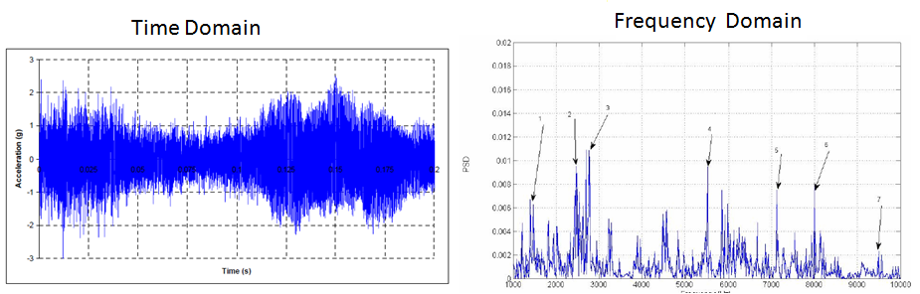
PP - Data transformation
Map data to a new space
e.g.) time domain -> frequency domain

Slide 29
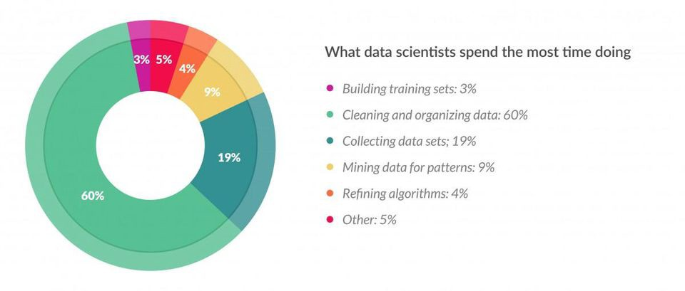
Closing comments
According to a survey in Forbes,
“data scientists spend 80% of their time on
data preparation.”

Slide 30

Q & A

